Slide 1






URBAN PLANT HEALTH DETECTION
GROUP MEMBERS-
Tanya Singh
Nakshatra Sawarkar
Shaikh Tauhid Shaikh Javed
Abhishek Wekhande

Slide 2

Learning Objectives
Understand how AI can assist agriculture by identifying plant diseases early.
Learn how to prepare and process large image datasets.
Gain hands-on experience building CNN models from scratch.
Learn how to:
Avoid overfitting with dropout and augmentation
Interpret performance through evaluation metrics
Improve results with proper tuning
GOAL
Source :
www.freepik.com/

Slide 3
Tools and Technology used
Platform: Google Colab
Language: Python
Libraries:
Pandas,Numpy
TensorFlow / Keras – for deep learning
OpenCV / PIL – for image processing
Matplotlib / Seaborn – for visualizations
scikit-learn – for evaluation metrics
Dataset Source: Kaggle

Slide 4
Methodology
Dataset:
New Plant Diseases Dataset (Augmented) from Kaggle.
Over 87,000+ images, labeled across 38 classes (diseased and healthy conditions for multiple plants).
Steps:
1. Preprocessing:
Resize images to a uniform shape (128x128).
Normalize pixel values.
Apply data augmentation: rotation, flipping, zoom.
2. Model:
Custom CNN architecture built using Keras.
Layers: Conv2D → MaxPooling → Dropout → Dense layers.
Trained using categorical_crossentropy and Adam optimizer.

Slide 5
Methodology
3. Training & Evaluation:
Train/validation split: 80/20.
Epochs: 10
Final Validation Accuracy: 91.26%
Evaluated using:
Confusion matrix
Classification report (Precision, Recall, F1-Score)

Slide 6
Problem Statement:
Plants are highly susceptible to diseases that can spread quickly and damage entire crops. Manual diagnosis is often slow, inaccurate, and requires expert intervention, making early detection challenging.
There is a need for a fast, automated, and accurate solution to detect plant diseases from leaf images to prevent contamination and reduce crop loss.

Slide 7
Solution:
Develop a deep learning-based image classification model that can detect whether a plant leaf is healthy or diseased.
Use a large dataset of labeled images to train a model that generalizes well across multiple plant types and diseases.
Provide early warnings so farmers can isolate diseased plants and take preventive measures.

Slide 8
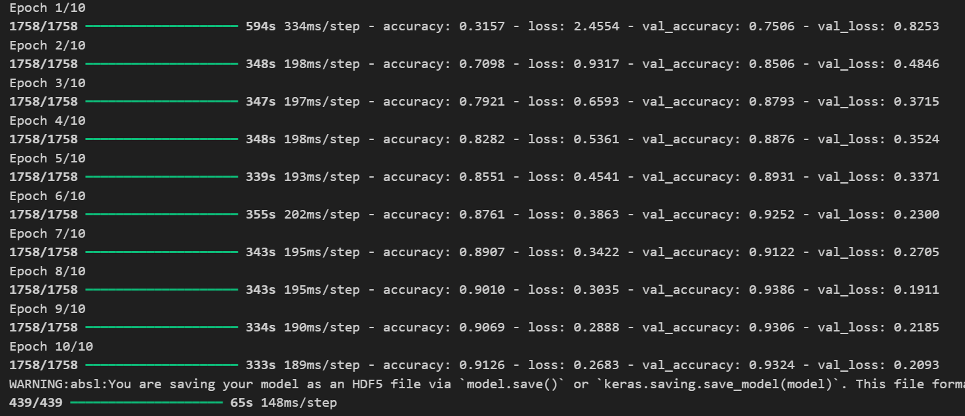
Screenshot of Output:
This screenshot shows that after 10 epochs, the model achieved a training accuracy of 91.26% and a validation accuracy of 93.24%, with training loss reduced to 0.2683 and validation loss to 0.2093, indicating strong performance and effective learning without overfitting.

Slide 9
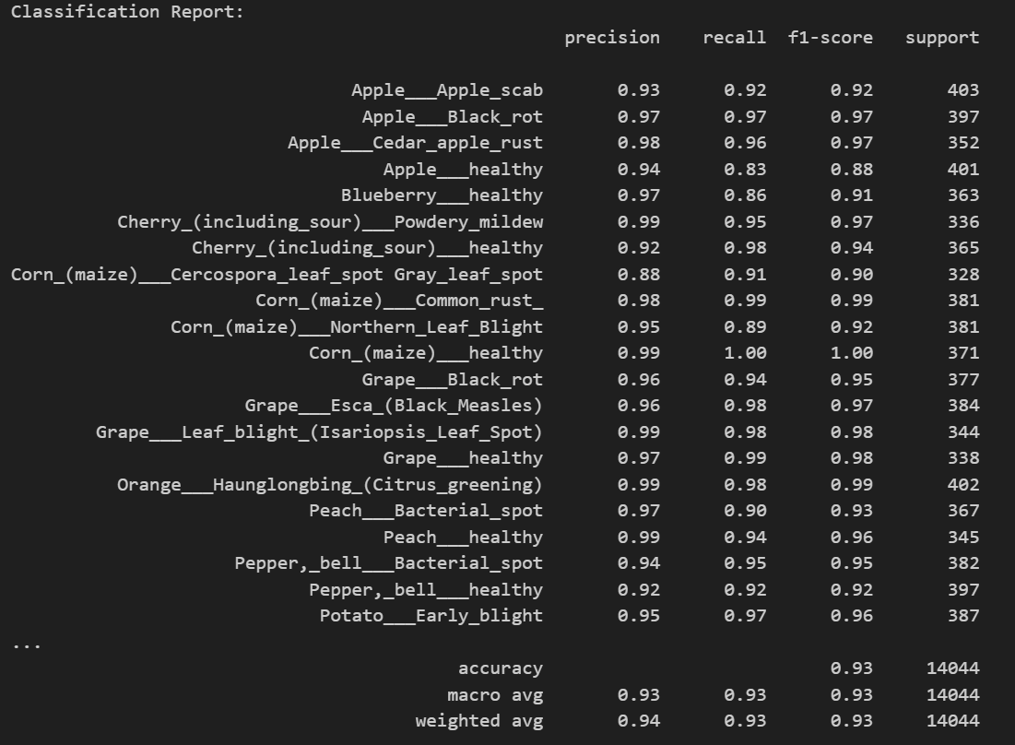
Screenshot of Output:
This classification report shows a high-performing model with an overall accuracy of 93%, demonstrating strong precision, recall, and F1-scores across multiple plant disease categories.

Slide 10
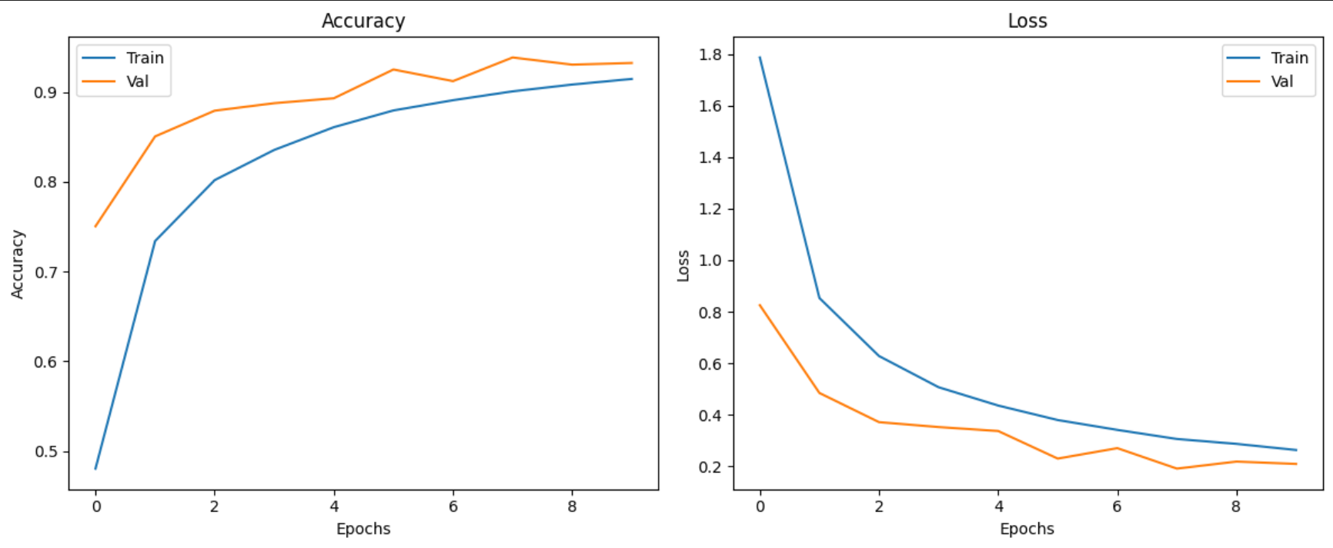
Screenshot of Output:
The graphs show that the model's training and validation accuracy steadily increased, reaching over 91%, while the loss consistently decreased, indicating effective learning and good generalization.

Slide 11
Conclusion:
Built a plant disease detection system using CNN with an accuracy of 91.26%.
The model is capable of detecting multiple diseases across 38 different classes.
Can help farmers intervene early and reduce crop loss.
Future Enhancements:
Integration with drone imaging
Expansion to more crops and real-field images
Github link- https://github.com/Abhishek220704/plant-disease-app

